Slide 1

Struktur Data
Linked Lists
Prepared by
Frans Panduwinata, S.Kom, M.T

Slide 2

Introduction
A linked list is a data structure that is used to model such a dynamic list of data items.
An array is represented in memory using sequential mapping, which has the property that elements are fixed distance apart.
But this has the following disadvantage:
  It makes insertion or deletion at any arbitrary position in an array a costly operation, because this involves the movement of some of the existing elements.

Slide 3
Introduction (cont)
When we want to represent several lists by using arrays of varying size,
  either we have to represent each list using a separate array of maximum size or
  we have to represent each of the lists using one single array.
  The first one will lead to wastage of storage, and the second
  will involve a lot of data movement.
So we have to use an alternative representation to overcome these disadvantages. One alternative is a linked representation.

Slide 4
Introduction (cont)
In a linked representation, it is not necessary that the elements be at a fixed distance apart.
Instead, we can place elements anywhere in memory, but to make it a part of the same list, an element is required to be linked with a previous element of the list.
This can be done by storing the address of the next element in the previous element itself.

Slide 5
Introduction (cont)
This requires that every element be capable of holding the data as well as the address of the next element.
Thus every element must be a structure with a minimum of two fields,
  one for holding the data value, which we call a data field, and
  the other for holding the address of he next element, which we call link field.

Slide 6
Introduction (cont)
Therefore, a linked list is
a list of elements in which the elements of the list can be placed anywhere in memory, and
these elements are linked with each other using an explicit link field, that is,
by storing the address of the next element in the link field of the previous element.

Slide 7

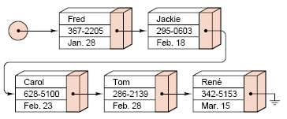
Introduction (cont)
The structure of a linked list:
EXAMPLE:

Slide 8
Chain
A chain is a linked list where each node contains a pointer to the next node in the list. The last node in the list contains a null (or zero) pointer.

Slide 9
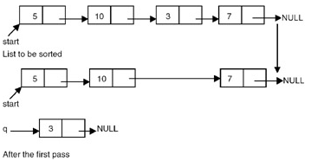
Sorting A Linked List
To sort a linked list,
  First we traverse the list searching for the node with a minimum data value.
  Then we remove that node and
  append it to another list
  which is initially empty.
  We repeat this process with
  the remaining list until
  the list becomes empty, and
  at the end, we return a pointer to the beginning of the list to which all the nodes are moved.

Slide 10
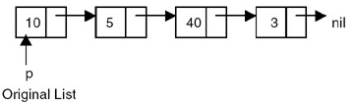
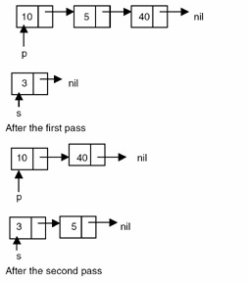
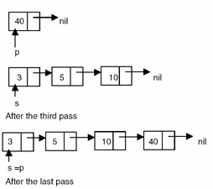
Sorting A Linked List (cont)
EXAMPLE:

Slide 11

Reversing a Linked List
To reverse a list,
  We maintain a pointer each to the previous and the next node,
  then we make the link field of the current node point to the previous,
  make the previous equal to the current, and the current equal to the next.

Slide 12
Reversing a Linked List (cont)
Code Sample:
struct node *reverse(struct node *p)
{
struct node *prev, *curr;
prev = NULL;
curr = p;
while (curr != NULL)
{
p = p-> link;
curr-> link = prev;
prev = curr; curr = p;
}
return(prev);
}

Slide 13
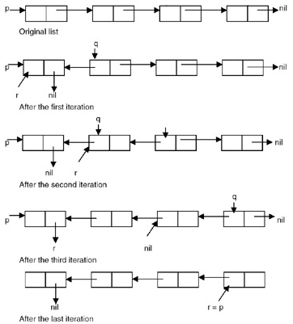
Reversing a Linked List (cont)
EXAMPLE:

Slide 14
Delete Node
Deleting the specified node in a singly linked list:
  To delete a node, first we determine the node number to be deleted.
  The list is then traversed to get a pointer to the node whose number is given, as well as a pointer to a node that appears before the node to be deleted.
  Then the link field of the node that appears before the node to be deleted is made to point to the node that appears after the node to be deleted, and the node to be deleted is freed.

Slide 15
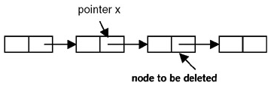

Delete Node (cont)
EXAMPLE:
Before deletion:
After deletion:

Slide 16
Insert Node
Inserting a node after the specified node in a singly linked list:
  To insert a new node after the specified node, first we get the number of the node in an existing list after which the new node is to be inserted.
  The list is then traversed to get a pointer to the node, whose number is given. If this pointer is x, then the link field of the new node is made to point to the node pointed to by x, and the link field of the node pointed to by x is made to point to the new node.

Slide 17
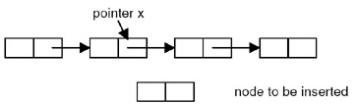
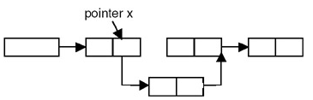
Insert Node (cont)
EXAMPLE:
Before insertion:
After insertion:

Slide 18
Insert Node (cont)
Inserting a new node in a sorted list:
  To insert a new node into an already sorted list, we compare the data value of the node to be inserted with the data values of the nodes in the list starting from the first node.
  This is continued until we get a pointer to the node that appears immediately before the node in the list whose data value is greater than the data value of the node to be inserted.

Slide 19
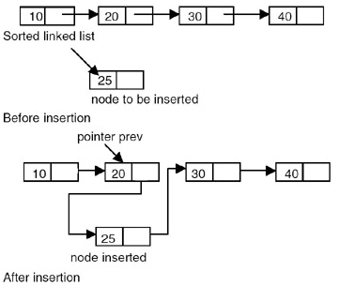
Insert Node (cont)
EXAMPLE:

Slide 20
Erasing a Linked List
Erasing a linked list involves
  Traversing the list starting from the first node,
  freeing the storage allocated to the nodes, and then
  setting the pointer to the list to NULL.
But a better strategy of erasing a list is
  to mark all the nodes of the list to be erased as free nodes without actually freeing the storage of these nodes.
  That means to maintain this list, a list of free nodes, so that if a new node is required it can be obtained from this list of free nodes.

Slide 21
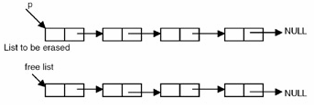
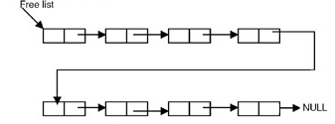
Erasing a Linked List (cont)
EXAMPLE:
Before erasing the list pointed to by p
After erasing the list pointed to by p

Slide 22
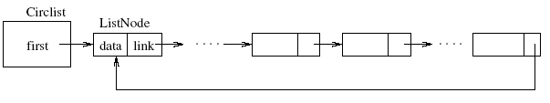
Circular Linked Lists
A circular list is identical to a chain except that the last node contains a pointer to the first node.

Slide 23
Doubly Linked Lists
The following are problems with singly linked lists:
  A singly linked list allows traversal of the list in only one direction.
  Deleting a node from a list requires keeping track of the previous node, that is, the node whose link points to the node to be deleted.
  If the link in any node gets corrupted, the remaining nodes of the list become unusable.
  These problems of singly linked lists can be overcome by adding one more link to each node, which points to the previous node.

Slide 24


Doubly Linked Lists (cont)
A doubly linked circular list differs from the chain and the circular list in that each node contains two pointers. One points to the next node (as before), while the other points to the previous node.
A doubly linked list maintained as chain:
A doubly linked list maintained as a circular list:

Slide 25
Doubly Linked Lists (cont)
Code sample for the nodes of a doubly linked list:
struct dnode
{
int data;
struct dnode *left,*right;
};

Slide 26
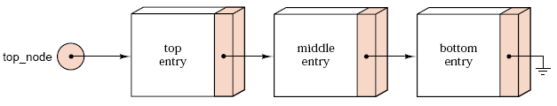
Linked Stack
The linked form of a stack:
The bottom of a Stack can always be identified as the node that contains a NULL link.

Slide 27
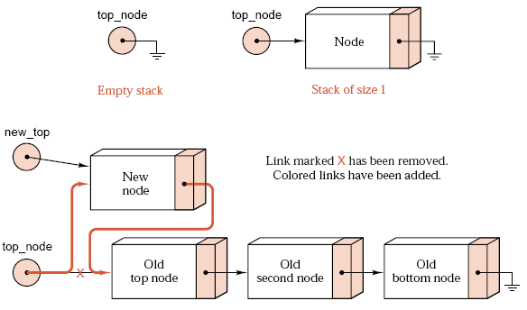
Linked Stack (cont)
Pushing a node onto a linked stack:

Slide 28
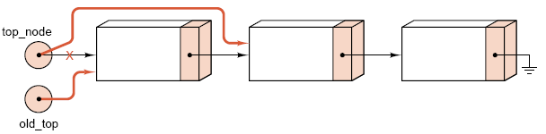
Linked Stack (cont)
Popping a node from a linked stack:

Slide 29
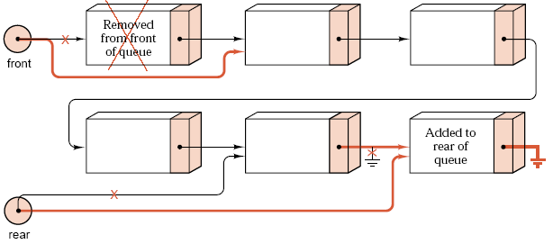
Linked Queues
Operations of insertion and deletion on a linked queue:

Slide 30
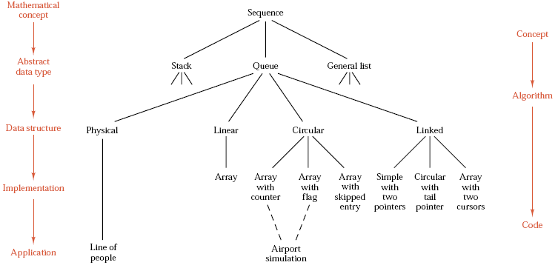
Overview
Refinement of queue:

Slide 31
Exercises
Write a program to delete a node with the minimum value from a singly linked list.
Write a program that will remove a specified node from a given doubly linked list and insert it at the end of the list.

